Slide 1
Operational considerations 2016-
All fisheries
Daily catch reporting
Small trial of changing from current daily reporting to collecting haul-by-haul info. (cf. CCAMLR C1/C2) daily.
Advantages – consistency, reduced no. of datasets, real-time snagging.
Consult industry to id limitations (e.g. time lags, IT considerations).

Slide 2
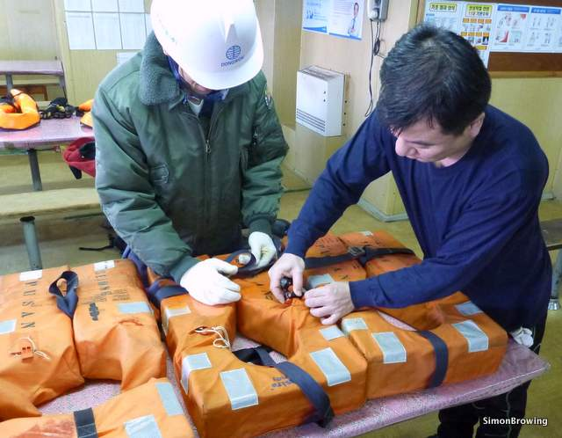
All fisheries
Torremolinos inspections
Satellite monitoring

Slide 3
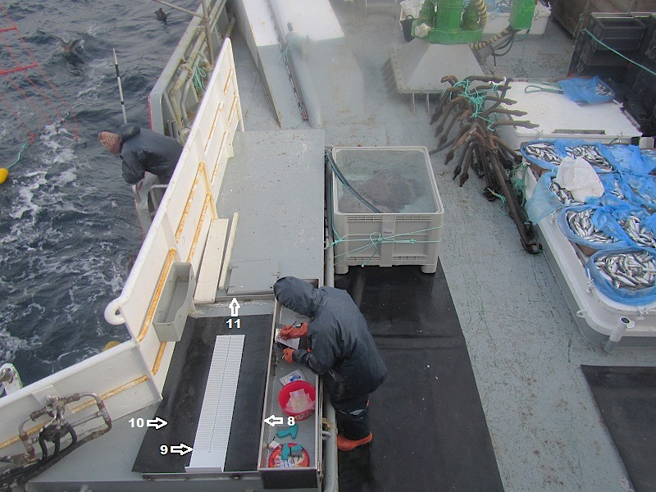
Roaming scientific observer initiative to continue
Successful in supporting observers, sharing best practice, carrying out extra sciences tasks.
Continue to improve observer workstations where necessary.
Notes:
.

Slide 4
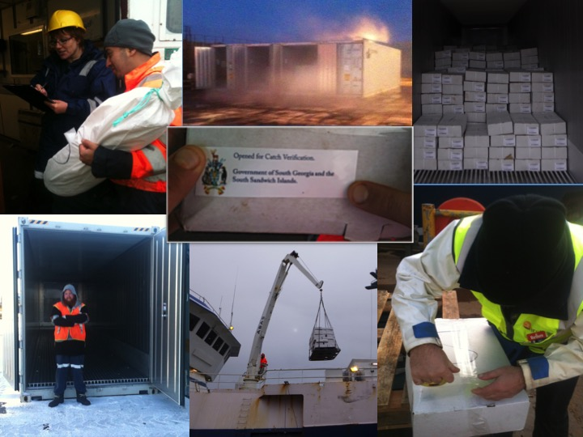
Toothfish
Research fishing – shallow lines, benthic closed areas and south of South Sandwich Islands.
Change from Intertek to Acoura Marine – business as usual.
Future of South Georgia Group Entity (MSC Chain of Custody)
We will continue to rigorously verify toothfish catches.

