Slide 1
Government of South Georgia & the South Sandwich Islands
Fishing Industry Meeting – 2017

Slide 2
Agenda
Welcome and introductions (FCO/GSGSSI)
2017 season overview (GSGSSI), incorporating
    research report-back (CEFAS)
    use of CCTV on fishing vessels (Argos Froyanes)
    groundfish survey and research update (BAS)
    toothfish ecology (Katie Brigden)
Stock assessment forward look (CEFAS)
CCAMLR update (FCO)
Toothfish MSC re-assessment (Acoura Marine)
Forward look (GSGSSI)
Q&A

Slide 3
2017 Season Review
South Georgia & the South Sandwich Islands
Industry Meeting 13th September 2017
Sue Gregory

Slide 4
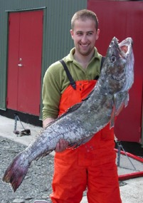

SG & SSI Fisheries
Patagonian Toothfish (48.3)
Patagonian Toothfish (48.4)
Antarctic Toothfish (48.4)
Krill
Mackerel Icefish

Slide 5
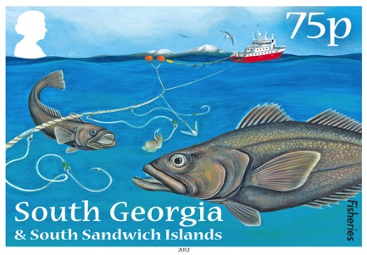
48.3 Patagonian Toothfish
6 vessels fished
Catch limit of 2,200 tonnes
510 fishing days
7,656,328 hooks set
13,040 km of line
2,192 tonnes caught

Slide 6
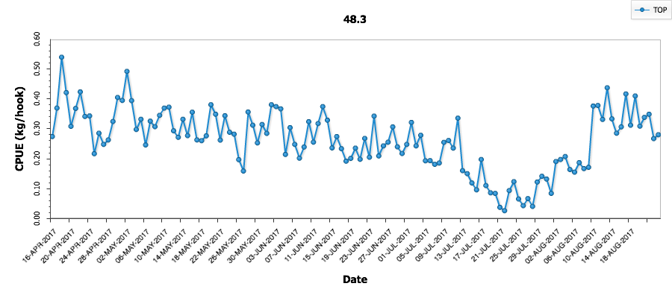
Catch Per Unit Effort

Slide 7
Catch Per Unit Effort
Area C closed

Slide 8
Catch Per Unit Effort
Area C reopened

Slide 9
Catch Per Unit Effort
Full moon!

Slide 10
Interannual comparisons

Slide 11
Bird bycatch
Early season issues with White chinned petrels
Multiple factors? Post rat eradication numbers increasing? Nutritionally stressed birds? Environmental factors (full moon, clear night)?
All mitigation measures are being fully implemented – not a compliance problem
Vessels proactively trying to find a solution
Chris covering in more detail later…

Slide 12
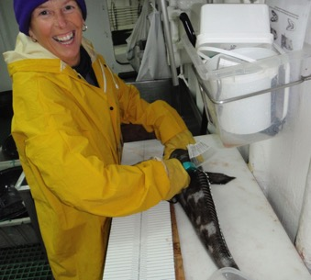
48.3 Research
Tagging programme
- Toothfish: 3,477 tagged, 873 recaptured
- Skate: 1,458 tagged, 74 recaptured
Benthic Closed Areas
Shallow Lines
Temperature loggers
Marmam obs
Bird observations

Slide 13
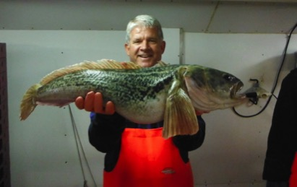
Roaming Observer
Fourth year of programme, third season for Peter Lafite
Documenting best practice & suggesting improvements
Ensuring continuity across vessels e.g. CF’s, bycatch reporting, skate handling
Supporting CCAMLR observers

Slide 14
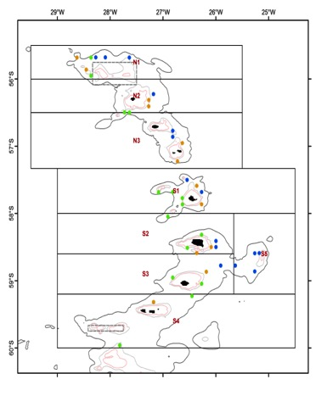
48.4 TOP and TOA fishery
Two vessels
15 research lines per vessel
‘Challenging’ fishing this season
Catch limit:
TOP 43t (27.9 t taken)
TOA 35t (19.4t taken)
48.2/48.4 research survey

Slide 15
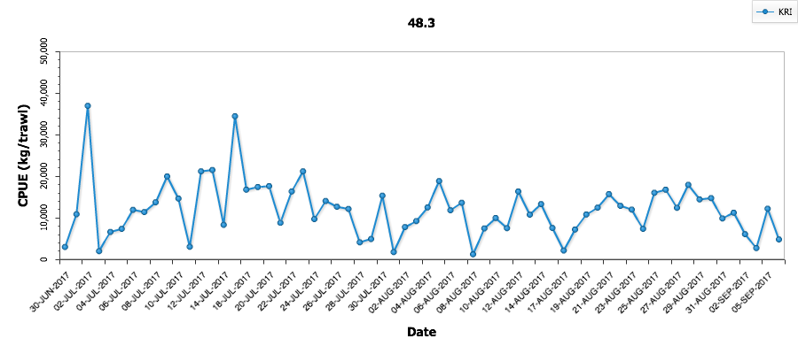
South Georgia Krill Fishery
8 vessels applied
5 vessel fished (+ Antarctic Endeavour pending)
Comparatively late start to the season: 30 June
Highly variable daily catches

Slide 16
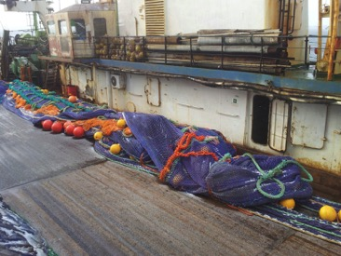
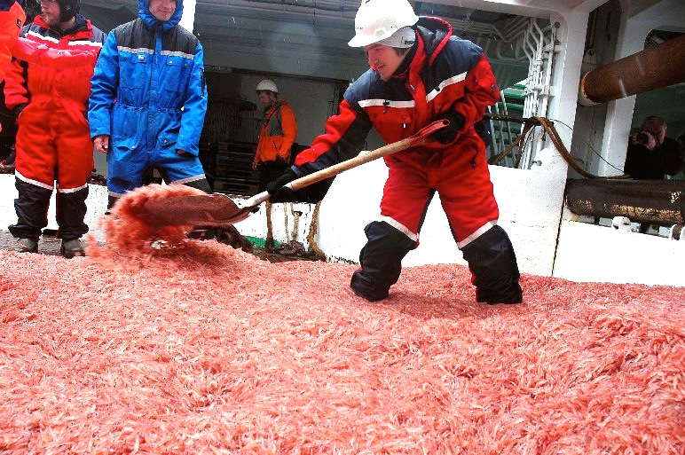
South Georgia Krill Fishery
100% observer coverage and a roaming observer
2017 requirement for minimum standard of observer workstation

Slide 17
CCAMLR krill fishery
CCAMLR catch limit of 5.61 million tonnes Area 48;
Interim limit of 620,000t with subarea limits:
  48.1: 155,000 tonnes
  48.2: 279,000 tonnes
  48.3: 279,000 tonnes
  48.4: 93,000 tonnes
Catches in 2016/17
  48.1: 149,334 tonnes
  48.2: 69,046 tonnes
  48.3: 18,500 tonnes (11/9)

Slide 18
Mackerel Icefish
Current season TAC 2,074 tonnes
14 days fishing in October 2016 (29 trawls)
12 days commercial fishing Feb 2017 (32 trawls)
Low catches so far in 2016/17 season
Groundfish survey (30 Jan – 7 Feb 2017)
  17 tonnes, some unexpected species caught
Vessels expected to return in October with trials of new net

Slide 19


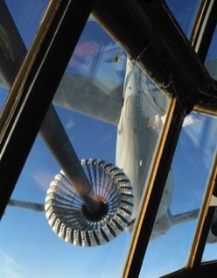
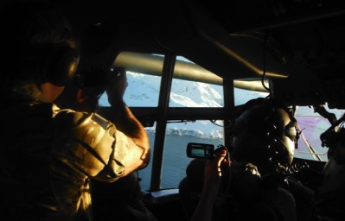
Maritime Patrol Flights
Two maritime patrol flights this season
Overflights of SG & SSI MZ
Operational focus on areas vulnerable to IUU and fishing grounds

Slide 20
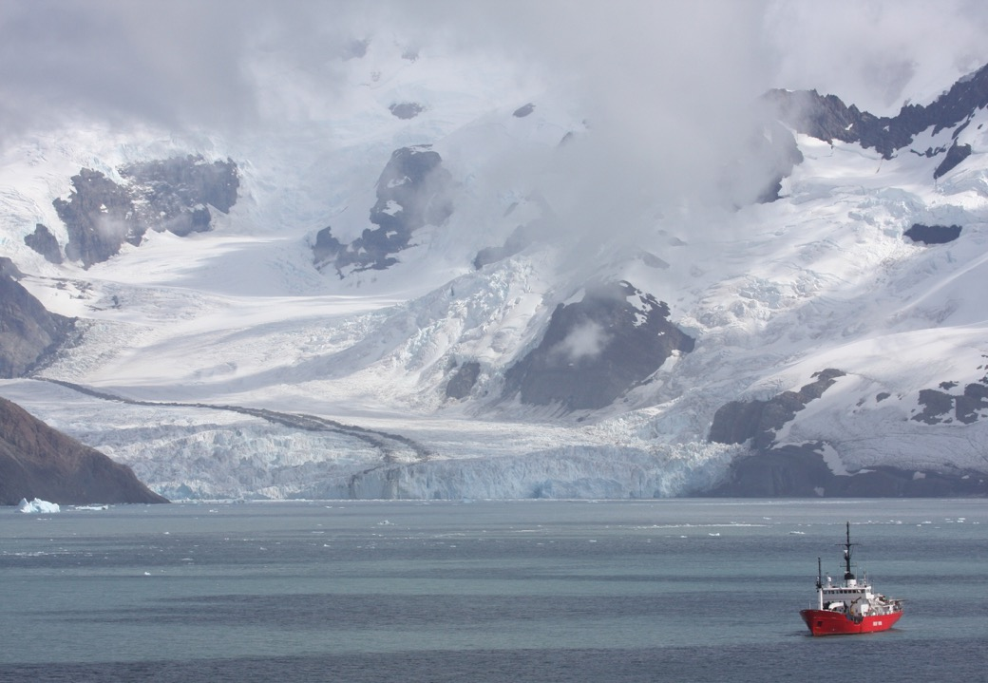
Thank You
- @GovSGSSI
- www.gov.gs
- sue.gregory@gov.gs

Slide 21

13 September 2017
FCO
Kylie Bamford
Marine Conservation Manager
South Georgia Fisheries Science and Industry Meeting

Slide 22
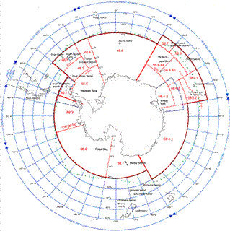
CCAMLR XXXIV – KEY PAPERS
Second Performance Review
  Science – representative system of MPAs and improved mechanisms to coordinate and deliver research activities among Member States;
  Management – address issues of non-SOLAS vessels, Compliance Evaluation Procedure strengthened and improvements to transhipment data recording.
Reviewing compliance Conservation Measures
  Revision of CM 10-08 and 10-05;
  Compliance report.

Slide 23
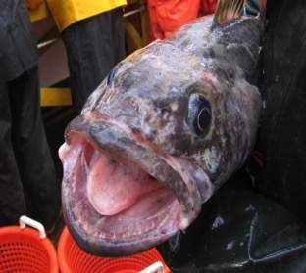
CCAMLR XXXIV – KEY PAPERS
Proposals for Marine Protected Areas
  Ross Sea (New Zealand and the USA) – R&M programme, monitoring marine traffic;
  Weddell Sea MPA – Norwegian paper;
  East Antarctic MPA (Australia, France, EU).
Research fishing
  How to manage research proposals
  Area 48

Slide 24
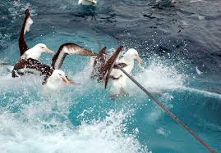
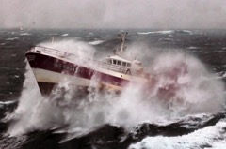
CCAMLR XXXIV – KEY PAPERS
Climate Change
  Designation of Larsen C newly exposed marine area
System of International Scientific Observation
  Implement recommendations of the review panel
System of Inspection
  Update of form and introduction of Radio Inspection Form

Slide 25
Questions?

Slide 26
Forward Look

Slide 27
Licensing and management in the toothfish fishery
proposal to establish a 4-year licensing regime
stronger focus on:
  compliance (compliance record, due diligence…)
  safety and welfare (vessel, crew, structural, social…)
  raising standards (experience, science, innovation…)
start application process in October, outcome in December
fishery management plan providing a framework to guide applications and engagement

Slide 28
When will the fishery begin?
bird by-catch creating an early-season problem;
options?
  delay opening to early May;
  spatial management to avoid hot-spots;
  trialling bird by-catch mitigation techniques

Slide 29
New compliance and enforcement model
variable and fixed administrative penalties based around a system of penalty points
points attributed to offences proportionate to severity
above a certain threshold --> suspension for season or revocation for licence period
points remain for 4 years, and inform licence application process

Slide 30
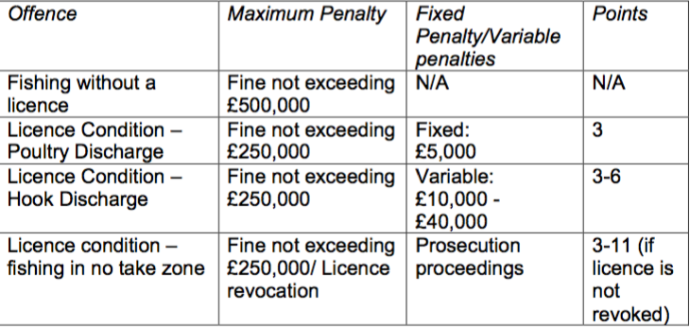
Example of proposed penalty system

Slide 31
Other issues
Management Areas B & C
  vessel-specific quotas / spatial management and other whale mitigation / first come first served
Continuing research in 48.2/48.4
  understanding toothfish stocks and ecosystem
  addressing linkages between 48.4 & 48.3 stock
Addressing the MSC requirements
  focus on benthic interactions including camera trials

Slide 32
Developments in fishery management
further enhance operational standards in the krill fishery
  welfare and safety (ILO 188)
  sustainability (ARK)
krill transects to collect abundance and by-catch data
use of heavy fuel oil and bunkering
  HFO carriage and use: spill risk “critical” (a “possible” likelihood with “major” consequences)
  bunkering: spill risk “high” (an “unlikely” likelihood with “severe” consequences)
  restrictions already apply S of 60; same ecosystem and limited response capacity
  c. 20% of fishery/support vessels affected (cruise vessels already compliant)

Slide 33
Marine Protected Area Review
5 years on, first review
relatively short timeframe for long-term goals
evaluate current data collection and monitoring programmes and data gaps
chart developments in scientific understanding and identify priorities for future research
May 2017 – data prioritisation workshop
August 2017 – call for stakeholder submissions
November 2017 – 2-day workshop
May 2018 – report

