Slide 1
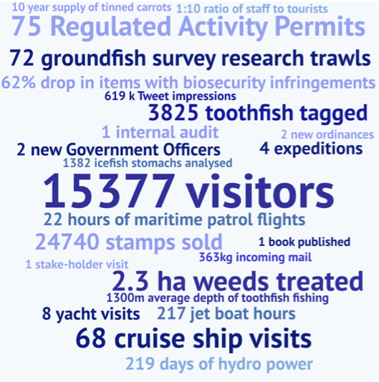

Slide 2
Government of South Georgia & the South Sandwich Islands
Annual Report of Progress – 2017

Slide 3


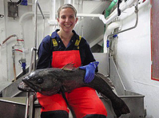
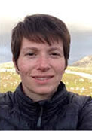



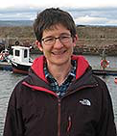
Our Team

Slide 4
ENVIRONMENT
To conserve the Territory’s environment, minimise human impacts and, where practicable, restore the native biodiversity and habitats

Slide 5
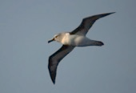
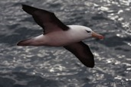
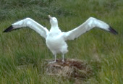
Conservation of albatross
Number of breeding pairs on SG
Launch of Conservation Action Plans – 5 priority actions
Collaboration with RSPB and BAS on monitoring / mitigation
Supporting albatross science
Priority research area for fishery
Outreach – Polar Biology paper, submitted to ACAP, stamp issue, Radio 4
44%
18%
17%

Slide 6
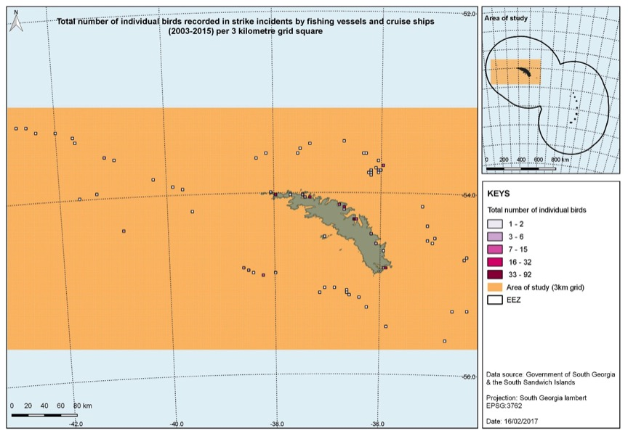
Mapping bird and vessel interactions

Slide 7
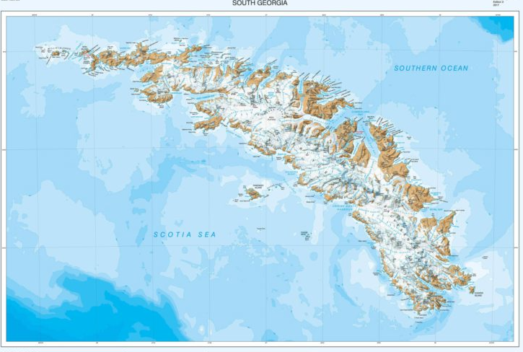
New map of South Georgia
High resolution map, updated from 2004;
New features including bays and lakes created by glacier retreat;
A more detailed map of the Shackleton Crossing
Marking occasion with a Mapping of South Georgia stamp issue;
Integrating data about South Georgia into the GIS.

Slide 8
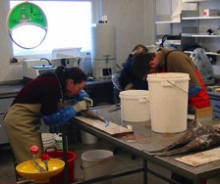
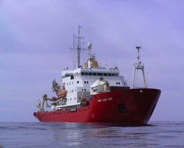
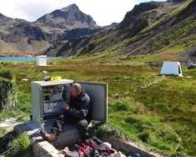
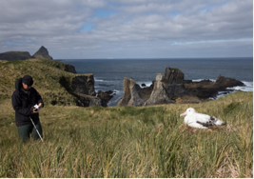
Regulated Activity Permits

Slide 9
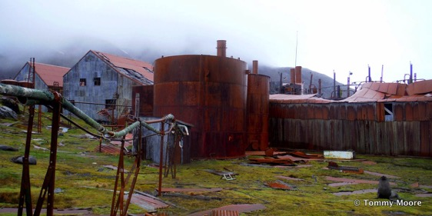
Assessing heavy fuel oil and options for its remediation /removal
site clearance by Christian Salvesen plc, the final leaseholder in 1991;
some oil remains in the tank bases and connecting pipes;
survey work April – May 2017 over 5 sites;
estimated c. 375 cubic metres of fuel oil remaining;
provided an assessment of priority.

Slide 10

Biosecurity and invasives management
Biosecurity Handbook updated
Annual biosecurity review:
  213 biosecurity inspections on cargo/baggage
  926 individual items checked
  24 infringements (biosecurity policies not followed) i.e. 2.5% cargo needing remedial action
Deploying:
  42 rodent monitoring stations
  82 mice/invertebrate traps
  96 stations added to complement on vessels
  annual weed management team – 2.3ha weeds treated; 3 new species discovered
Supporting SGHT in 2017/2018 monitoring project (c. £80k excluding vessel charter time)

Slide 11
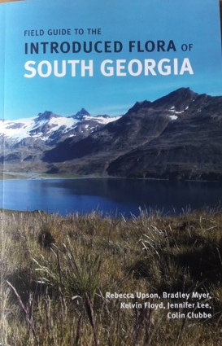
Developments in biosecurity and invasives
Field Guide to the Introduced Flora of South Georgia
  published August 2017
trial rodent detector dog
  contract negotiations underway
  upstream biosecurity
dedicated BI biosecurity facility
  part of re-development funded by NERC
enhanced biosecurity facility at KEP
  part of re-development of wharf
collaborations
  GB Non-native Species Secretariat
  Falkland Islands

Slide 12
FISHERIES
To manage SGSSI fisheries to the highest international standards of operation, stewardship and sustainability

Slide 13
Overview of Season - Toothfish
South Georgia Toothfish Fishery
  6 vessels, 2,200 tonne quota
  precautionary – target of 55% virgin biomass in the 35 year stock projection
  vessel science improves stock assessment and sustainability, including tagging c. 3,500 fish, temperature loggers, bird/mammal observations
  whale depredation higher
South Sandwich Islands Toothfish Fishery
  2 vessels, 78 tonnes
  finding out more about the stock and geographic spread

Slide 14
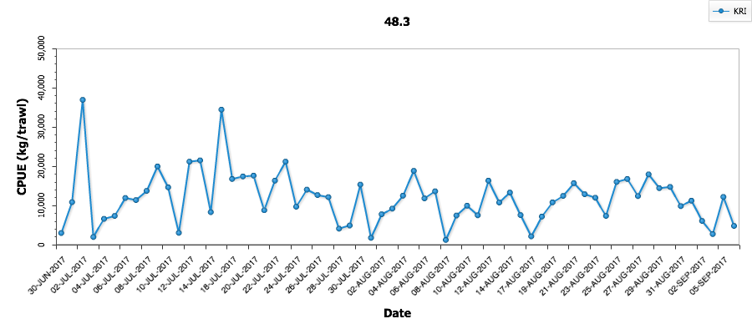
Overview of Season – Icefish and Krill
Icefish Fishery
  2 vessels, 2,074 tonne quota
  biennial groundfish survey:
    conducted 72 research trawls, 1,382 icefish stomachs analysed
    estimates icefish biomass at 90,912 tonnes
    provides information on recruitment into the toothfish fishery and abundance of non-target species, and camera images of substrate and habitat type
Krill fishery
  6 vessels, comparatively late start to the season (30 June) and variable daily catches
  international observer requirement and minimum workstation requirements

Slide 15
Overview of Season – Research Fishing in 48.2/48.4
other CCAMLR Members looking at potential for commercial fishery on Antarctic toothfish;
UK-led controlled scientific survey:
collect information on toothfish population and movement of fish;
better understand ecology of the region;
operate over 3 years ending 2019
results contribute to conservation and management objectives of SGSSI MZ

Slide 16
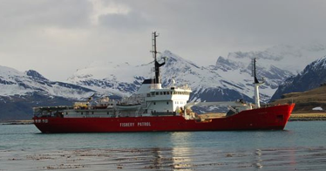
Overview of Season: Fisheries Patrolling
fishery patrol vessel Pharos SG
  deployed >200 days so far this year
  at-sea inspections on licensed vessels across fisheries
regular maritime patrol flights of SG and SSI
  operational focus on areas vulnerable to IUU and fishing grounds
satellite surveillance trial
visits by HMS Clyde, HMS Portland and HMS Enterprise

Slide 17
Developments in fishery management
consultation on changes to the management of the toothfish fishery
  proposal to extend the toothfish licensing period from 2 to 4 years
  stronger focus on welfare and safety, compliance and raising fishery standards (science and innovation)
  potential to extend to the icefish fishery in due course
further enhance operational standards in the krill fishery – welfare and safety, sustainability (ARK)
use of heavy fuel oil and bunkering
  restrictions already apply S of 60; same ecosystem and limited response capacity
  c. 20% of fishery/support vessels affected (cruise vessels already compliant)
MSC re-certification of the toothfish fishery
  public comment draft report due for publication in May 2018
  future focus likely on benthic interactions

Slide 18
VISITOR MANAGEMENT
To facilitate visits that are safe, responsible, environmentally-sensitive and contribute to sustainable management, creating future ambassadors for the Territory

Slide 19
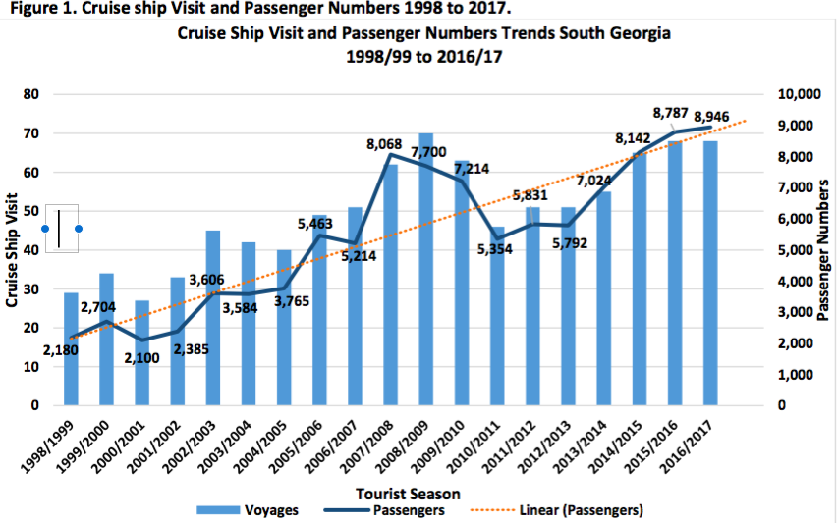
Annual tourism report

Slide 20
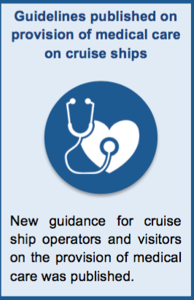
Medical review
completed November 2016 following Coroner’s recommendations into fatality on South Georgia;
developed in consultation with industry and following medical expert peer review process;
guidelines to be adapted depending on nature of visit, passengers and vessel

Slide 21
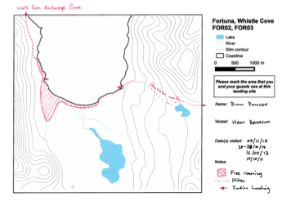
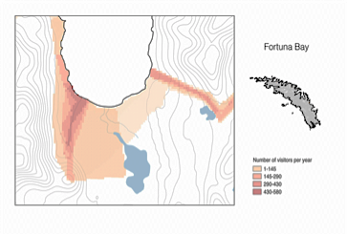
Development of Terrestrial Protected Areas
contributing to commitments under the Convention on Biological Diversity;
responding to data needs and future threats e.g. climate change
stronger basis for visitor management policy
better understand visitor use patterns and current footprint (cruise ship, yacht, BAS, GSGSSI)

Slide 22
HERITAGE
To preserve, where practicable, and bring to a wider international audience the heritage of South Georgia

Slide 23
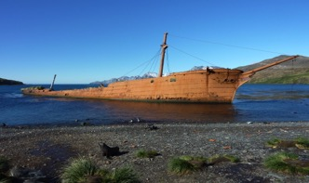
Developing South Georgia’s heritage policy
Cataloguing sites, structures and key artefacts
Heritage relevant to whaling and sealing, scientific expeditions and exploration
Development of a draft heritage framework and strategy
Categorisation to reflect the significance, location, suitability for conservation (or restoration) and long-term management considerations
Policy on the release and movement of artefacts
Conservation management plan

Slide 24
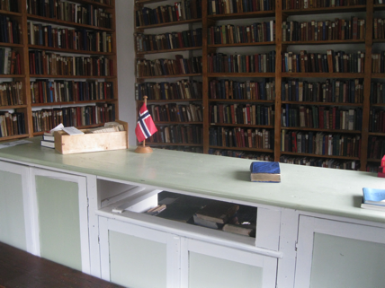
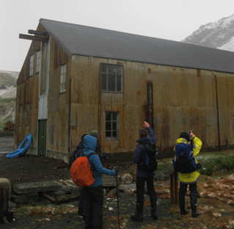
Works 2017 – 2018, incorporating...
1. Main stores
main roof replacement
re-painting
3. Historic huts
2. Church
window refurbishment
library re-painting
With thanks to co-funding from the Norwegian Directorate of Cultural Heritage and Oyas Venner

Slide 25
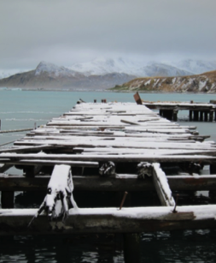
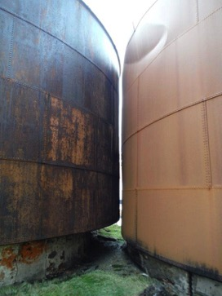
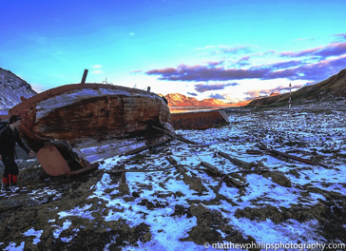
Remedial Works
Grytviken oil tanks
Small boats
Grytviken old jetty

Slide 26
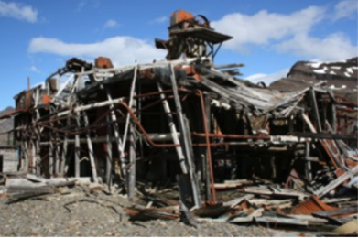
Asbestos Management Plan
effectively manage the risk from asbestos and ensure appropriate mitigation / remediation
key management actions identified – including standard procedures for operating around asbestos - tests indicate very low risk
raising awareness including training

Slide 27
Heritage outreach
Extension of Shackleton exhibition at South Georgia
Geometria laser survey and Shadow Industries’ award-winning ‘kiosks’
Initial discussions on collaboration with Stanley Historic Dockyard Museum
National Maritime Museum – New Polar Gallery SG display
Policy on the release and movement of artefacts to facilitate viewing and research

Slide 28
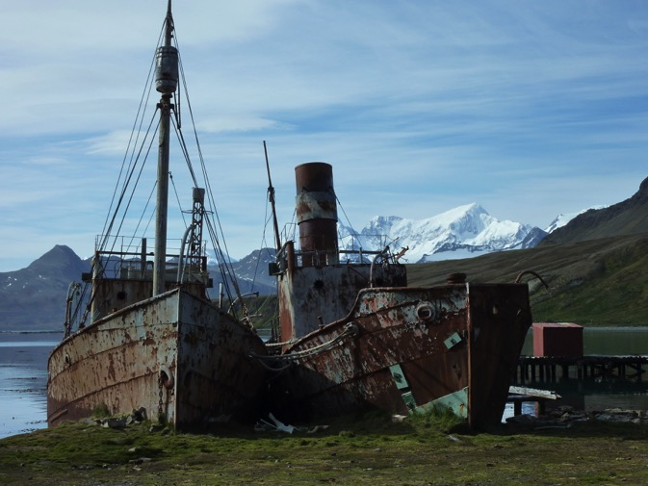
Viola / Dias

Slide 29
GOVERNANCE
To manage the affairs of SGSSI and the surrounding 200 nautical mile Maritime Zone through efficient and transparent government

Slide 30
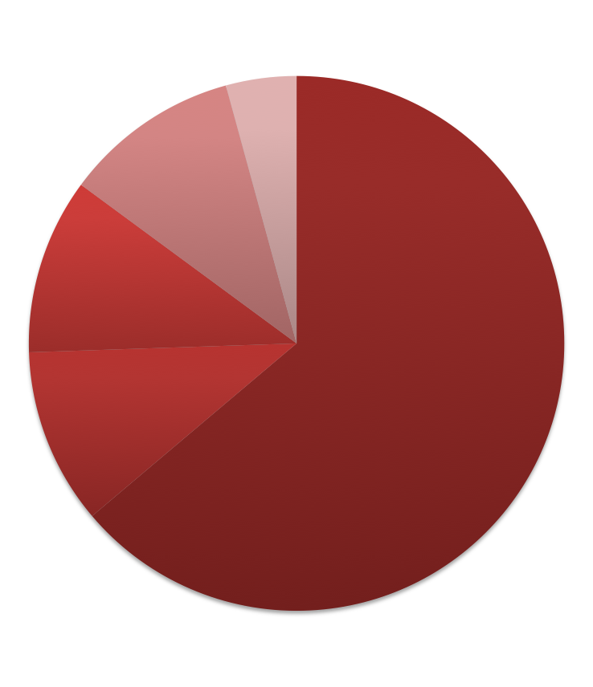
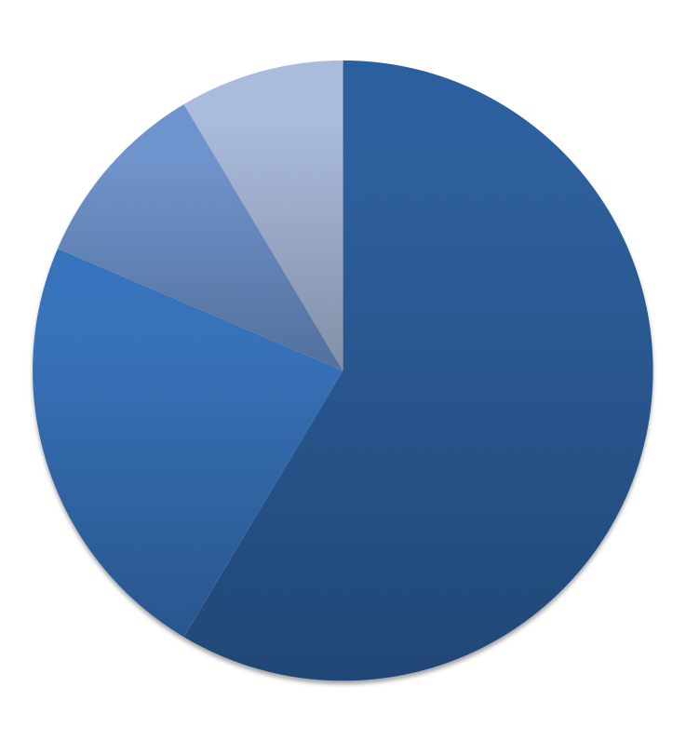
How is GSGSSI financed?
How is the money spent?
Stamps
Heritage
Other
Staff
Terrestrial conservation
Visitors
Sustainable fisheries
Marine management and protection
KEP
Est. cash revenue 2017 - £7.2m
Revenue 2016 - £7.5m
Est. cash expenditure 2017 - £6.3m
Expenditure 2016 - £5.7m
Notes:
.

Slide 31
Legislative review: customs, immigration and policing
updated and revised legislation for South Georgia’s current circumstances;
previous legislation dates back to whaling era;
customs and policing introduced 2016; immigration due 2017;
forthcoming legislation in relation to visitor management, fisheries and heritage.

Slide 32
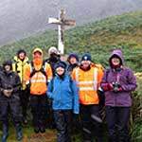
Stakeholder Visit

