Slide 1
Government of South Georgia & the South Sandwich Islands
Strategy 2016 - 2020:
One year on

Slide 2
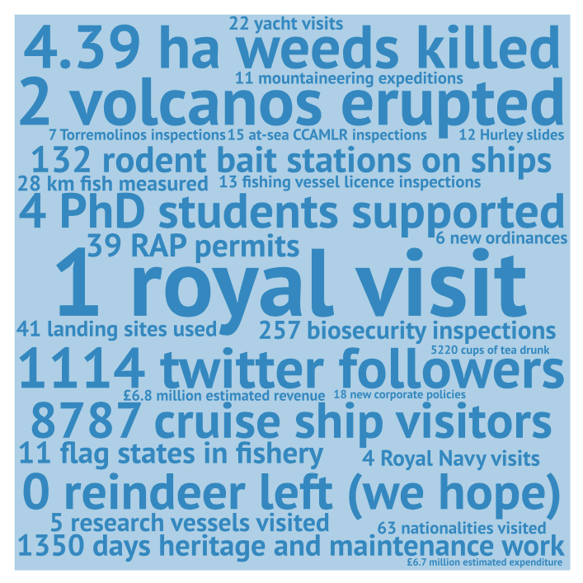

Slide 3
GOVERNANCE
To manage the affairs of SGSSI and the surrounding 200 nautical mile Maritime Zone through efficient and transparent government

Slide 4
Support the UK Government to safeguard sovereignty through good management, clear policy and modern legislation
Annual business plan 2016 – report December
Legislative review
  Current SGSSI legislation now online
  Preparing new legislation for 2017
  Consultation on Policing
Modernising internal practices and developing our policy framework

Slide 5
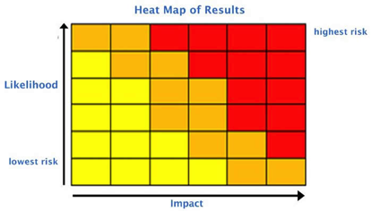
Identify and mitigate against GSGSSI liabilities through effective risk management policies.
Risk register and quarterly review
Top risks include:
  Biosecurity
  SG Communications
  Environment/Pollution
  Major incident
Incident planning
Annual exercise with BAS and MOD; working with FIG

Slide 6
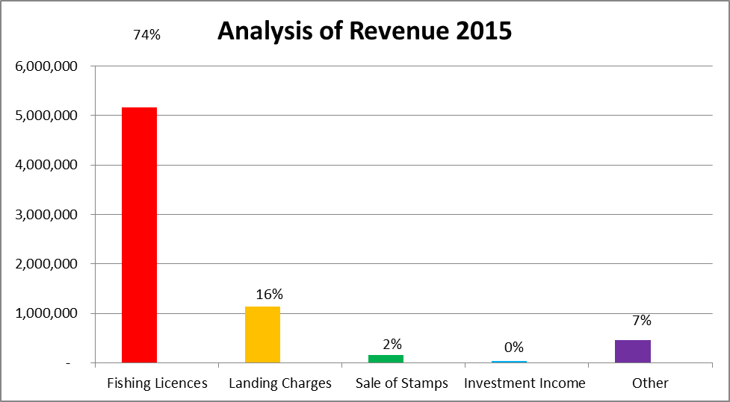
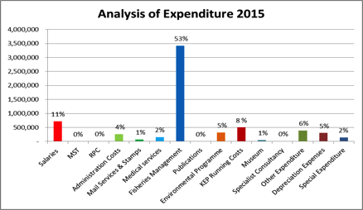
Ensure the long-term financial security of the Territory through prudent financial management, balanced budgets, and by maintaining at least one year’s operating costs in reserve.
Balanced budget (E £6.7m; R £6.8m)
2016 surplus anticipated due to savings and good krill year
Financial planning and policy

Slide 7
Ensure the implementation of obligations under international Treaties which have been extended to SGSSI and assist the UK Government’s engagement with Treaties and organisations relevant to the sub-Antarctic region.
Identifying treaties extended to GSGSSI and working with AG’s chambers to facilitate implementation. This year – CBD and ACAP
Work with the FCO in maintaining the UK’s influence within CCAMLR and ensuring SGSSI’s interests are supported and represented

Slide 8
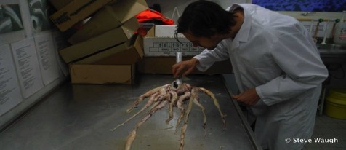
Encourage high quality science that supports our strategic objectives, and work with UK, regional and international organisations to promote research and collaboration
.
SG science inputs to toothfish stock assessment, conservation and fisheries management
Facilitating wider scientific interest and innovative research with current project proposals to BEST, Darwin Plus & 4 PhDs
No visitor fees for scientists

Slide 9
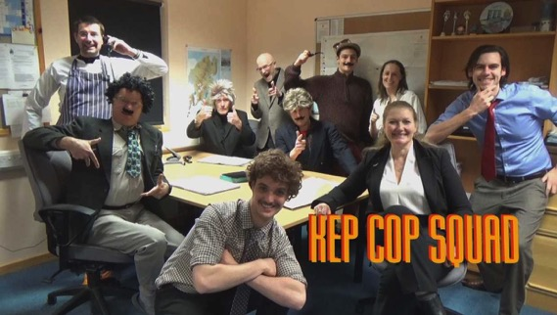
Good government and a clear and transparent approach to decision-making including through active stakeholder engagement, consultation…
Strategy 2016–2020 theme
Ongoing engagement and consultation
Closer links on South Georgia – between KEP and BI

Slide 10
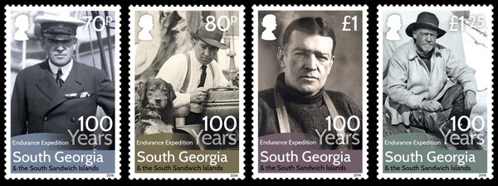
… and outreach
Marking the Shackleton Centenary
Commemorative stamps and coins
New GSGSSI website and twitter feed
Media and filming projects
Collaborations e.g. Historic Dockyard Museum; sub-Antarctic Territories; etc

Slide 11
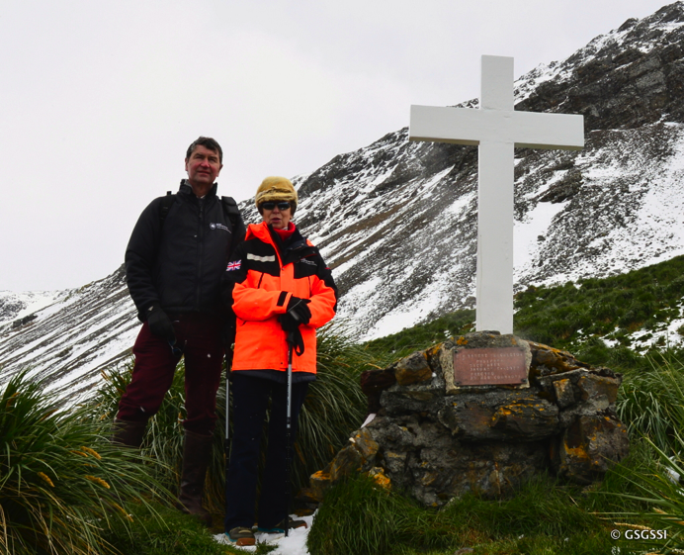
Royal Visit

Slide 12
ENVIRONMENT
To conserve the Territory’s environment, minimise human impacts and, where practicable, restore the native biodiversity and habitats

Slide 13
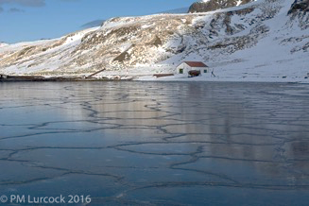
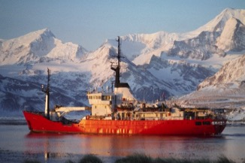
Integrate principles of environmental sustainability into Government policies and ensure that environmental management practices are fully transparent and conform to or exceed global standards
Hydroelectric power
Fuel efficiency on Pharos SG
Waste handling at KEP
Establish energy policy
  Baseline
  Improve

Slide 14
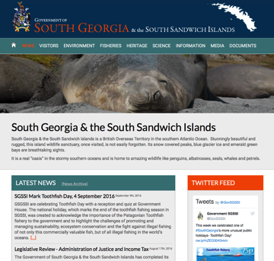
Increase SGSSI’s environmental global reach though collaboration and knowledge sharing with our stakeholders including the UK and other Overseas Territory governments and non-governmental organisations
Outreach
  Twitter (@GovSGSSI)
  Website (media releases, reports)
Knowledge sharing
  Biosecurity planning meetings FIG, MoD
  Regional ACAP group
  CCAMLR

Slide 15
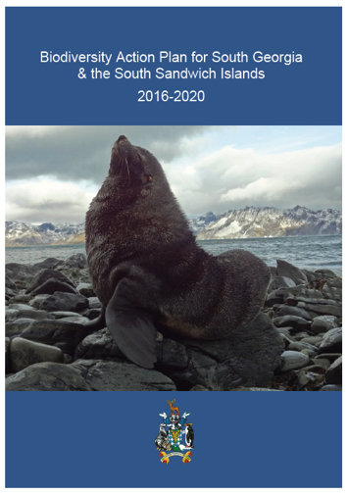
Ensure that our obligations under multilateral environmental agreements are met
Convention on Biological Diversity
National Biodiversity Action Plan
  Consultation
  (Dec-Jan 2015)
  8 organizations responded
  Launched March 2016
  Structure following overarching strategy
  Priority actions and timeframes identified
  Mapped against Aichi targets

Slide 16
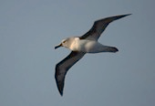
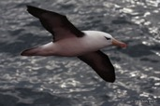
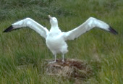
Agreement on the Conservation of Albatross and Petrels
Number of breeding pairs on SG
Round island survey manuscript submitted to Polar Biology
‘Priority populations’
Conservation Action plans developed
Support albatross science
Work with RFMOs
Focus on outreach and sharing best practice

Slide 17
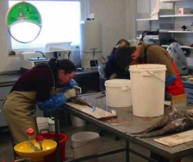
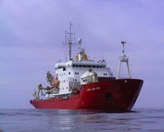
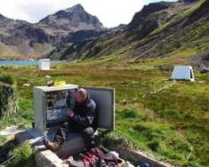
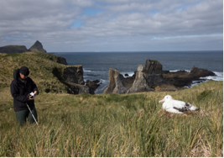
Develop standardised environmental assessment procedures which are scalable and commensurate with the potential impact the activity may have on the environment
Permits issued

Slide 18
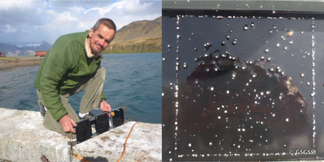
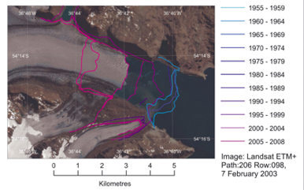
Enhance knowledge of biodiversity and habitats of SGSSI through research, monitoring and review, including to establish scientific baselines from which to assess environmental change including the potential effects of climate change
Marine settlement plates
  Baseline data
  Early warning system
  Equivalent system in FK
Fungal biodiversity PhD
  Baseline data
  Impacts of herbicide
Monitor glacial retreat
  Dispersal barriers
  New habitat creation
  BAS remote sensing

Slide 19
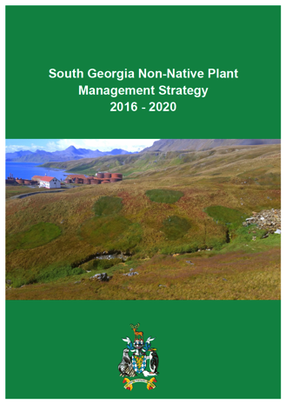
Effectively manage invasive alien species and work along the entire biosecurity continuum to deliver and enforce best practice biosecurity protocols, post-border monitoring and emergency response measures
Non-native plant strategy 2016-2020
  Culmination of Darwin project
  33 out of 41 species eradicated or at zero population density by 2020
  £250,000 funding commitment
  Indigena appointed
  Capacity building
  Citizen science

Slide 20
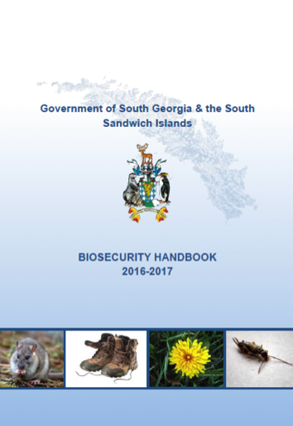
Biosecurity Handbook launched
Annual biosecurity review:
  257 biosecurity inspections
  885 items checked
  60 infringements
New electronic rodent monitoring at KEP
Future options for new biosecurity and cargo handling facilities at KEP and BI and enhanced vessel screening in Falklands
Support SGHT in 2017/2018 monitoring expedition

Slide 21
Adopting an evidence-based approach and using the best available data, establish appropriate protection of the terrestrial and marine environments through a suite of protected areas, ensuring that land-based activities are managed sustainably and with minimal impacts on the environment
Protected Areas
Purpose
e.g. wildlife, heritage, wilderness, scenic beauty, science, tourism
Spatial data
Reduce conflict
Management and review
Baseline data
Threats
Human impacts, local, global, natural

Slide 22
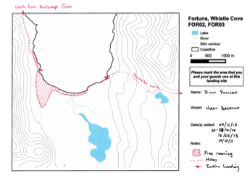
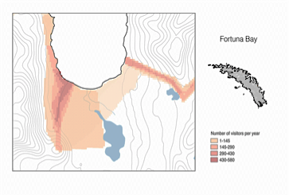
Visitor site use survey
Better understand visitor use patterns and current footprint (cruise ship, yacht, BAS, GSGSSI)
Ensure recreational use is accommodated in Protected Area network
IAATO workshop
  Areas for ‘free roaming’
  Understand ‘wilderness’
  Retain provision for expeditions and special projects
  Consideration for opening new sites e.g. Undine

Slide 23
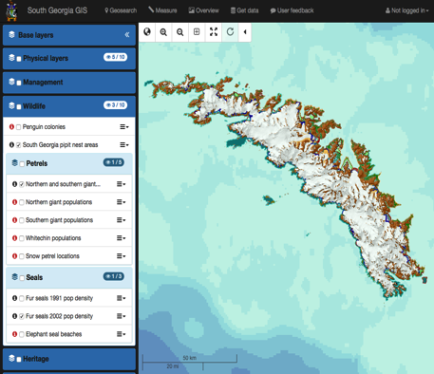
Next steps…
Update environmental data and GIS portal
Gather additional data on under represented species and habitats
Establish monitoring to better understand risk
Engage with experts and other stake-holder groups
Evidence based approach

Slide 24
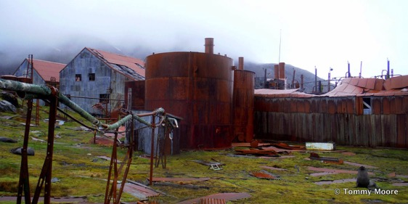
Understand and where possible mitigate the risks from substances that have the potential to harm the environment such as heavy fuel oil and pollutants present in old whaling stations
ITT scoping of oil remediation
Scoping trip planned for late 2016

Slide 25
FISHERIES
To manage SGSSI fisheries to the highest international standards of operation, stewardship and sustainability

Slide 26
Objectives - review
Precautionary management of stocks
Aim: To protect stock, and allow for uncertainty and resilience to unknowns.
Toothfish: target of 55% of virgin biomass in the 35 year stock projection
Toothfish: Data and feedback from Masters is that it was a good toothfish season.
Successful research fishing in closed areas – tag / release program
Successful shallow water fishing (550m) – recruitment index development
Krill: Season was very good; much better than predicted.
Progress in monitoring by-catch.
Identified need to monitor “mega-consumers” of krill
Icefish: Catch can elude commercial fleet.
Ground-fish survey early January will provide an update.
MSC recertification

Slide 27
Objectives - review
2. Develop fishery management plans
Aim: A resource for vessels and operators
to improve vessel management,
conservation, and science collaboration.
Updated annually
Contents include:
Current state of the fishery
Fishery management
Harvest control measures
Licence advice summary
Conservation, monitoring, science plans
Licensing, Compliance, Raising standards

Slide 28
Objectives - review
3. Raising standards
Aim: Phase out the carrying and use of heavy fuel oil across the fleet, including support and re-fueling vessels.
Currently consulting with specialists
Will commission a review of current status and options
Aim: Improve waste management on vessels
Increased awareness on all vessels of their responsibility to protect the environment through improvements in all aspects of operation, ranging from hook management to management of rubbish and domestic waste.
Aim: Improve vessel’s fishing “best practice”
131 days of “Roaming Observer” time, assessing consistency of observer data gathering, vessel conservation measures, and develop improvements to vessel data gathering and conservation practices.

Slide 29
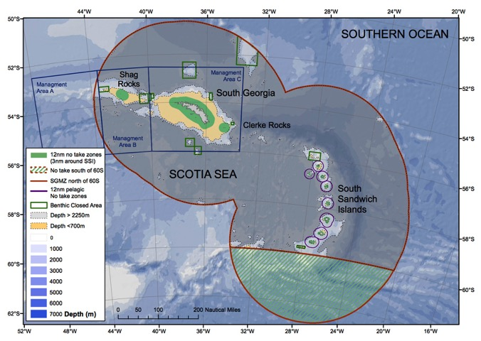
Objectives - review
4. Monitor performance of the MPA

Slide 30
MPA Review 2018
SG Fisheries
Sustainable Fisheries through science, management, and stakeholder collaboration

Slide 31
MPA Review 2018
SG Fisheries
Management Plan 2013
Sustainable Fisheries through science, management, and stakeholder collaboration
Precautionary and prudent protection of species, habitats and processes

Slide 32
MPA Review 2018
SG Fisheries
Management Plan 2013
Sustainable Fisheries through science, management, and stakeholder collaboration
Precautionary and prudent protection of species, habitats and processes
Review of Objectives and data
Present advice for the 2018 Management Plan

Slide 33
Review Process
  We will set up an ad-hoc review group with stakeholder representation
  Seek to:
    assess progress towards achieving the objectives of the sustainable use MPA
    evaluate the developing data collection, research and monitoring programmes
    provide options and advice for future science-based research, monitoring and management
  Review will be carried out during 2017-18
  Update on progress to be presented at 2017 South Georgia Stakeholder Meeting

Slide 34
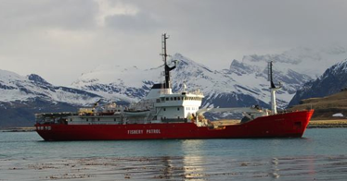
Objectives - review
On-going Objectives
Aim: Support the UK delegation to CCAMLR to represent SGSSI in the regional context
Building research science programs that study connectivity between 48.2, 48.3 and 48.4 in the toothfish and krill fishery
Aim: Maintain a strong compliance regime and protect the region from IUU fishing
Continual development of surveillance tools, and ensure a strong legal framework through review of legislation and training of compliance officers.

Slide 35
Objectives - review
On-going Objectives
Aim: Improve public awareness about the best-practice in the fisheries management.
A large base of Twitter followers
Working with NGOs to support our message in international fora.
Maintain a high profile locally in the Falklands

Slide 36
VISITOR MANAGEMENT
To facilitate visits that are safe, responsible, environmentally-sensitive and contribute to sustainable management, creating future ambassadors for the Territory

Slide 37
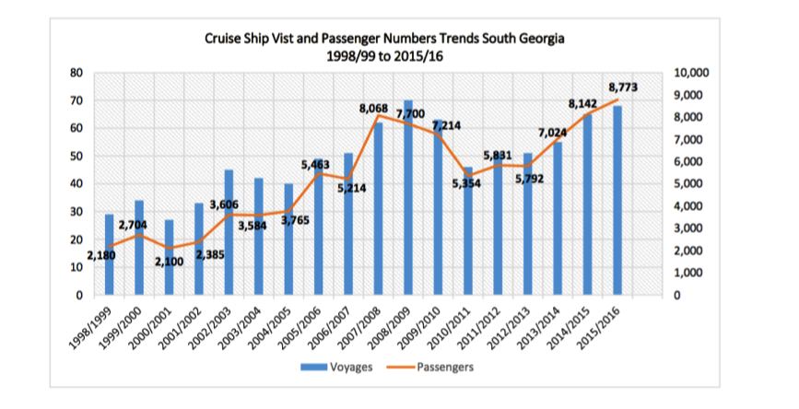
Adopt a collaborative, precautionary approach to visitor management to ensure safe, responsible visits conducted to the highest environmental standards.
67 cruise ship visits 8,773 passengers
21 Yacht visits 150 crew & passengers
11 Expeditions 86 participants

Slide 38
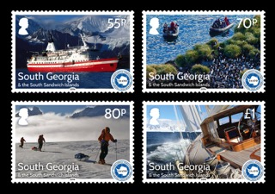
Recognising the important contribution tourism makes to the Territory, maintain our policy of engagement with …the International Association of Antarctic Tour Operators (IAATO)...
25th anniversary meeting and commemorative stamp issue
review of visitor landing sites
medical review – peer reviewed (October)

Slide 39
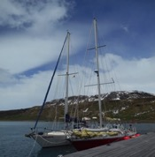
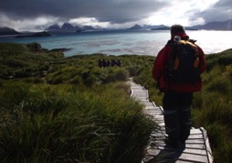
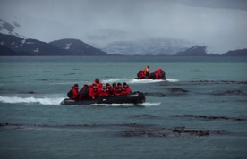
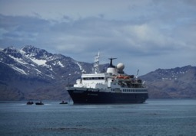
Work with stakeholders to promote education and outreach of our key shared messages and understand the views of visitors to better support the sustainable management of the Territory and enhance the future visitor experience.
responding to changing visitor demographic
engagement in our long-term management plans for Grytviken
involvement in environmental monitoring and citizen science – contributing to the SGGIS
incident planning and engagement with operators

Slide 40
Review and develop visitor management policy and legislation.
Streamlining of activity permitting and fees
Separate application process tailored to yacht operations and requirements
Revised immigration requirements for 2017
Updated legislation for visitor management – consultation during 16/17

Slide 41
HERITAGE
To preserve, where practicable, and bring to a wider international audience the heritage of South Georgia

Slide 42
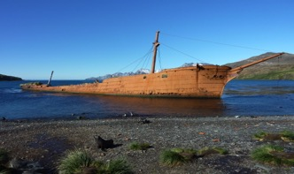
Develop a system to record SGSSI’s heritage sites, structures and artefacts with a view to developing a prioritised list to guide future management interventions, underpinned by new heritage legislation.
Cataloguing sites, structures and key artefacts
Heritage relevant to whaling and sealing, scientific expeditions and exploration
Categorisation to reflect the significance, location, suitability for conservation (or restoration) and long-term management considerations

Slide 43
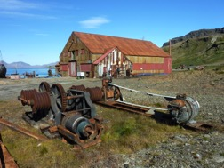
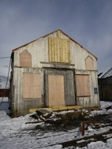
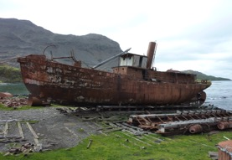
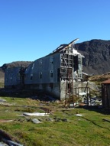
Proposed categorisation process
CATEGORY 1 Structures, sites or key artefacts requiring directed conservation or restoration with long-term management plan e.g. Engineer’s workshop / main stores
CATEGORY 2 Structures, sites or key artefacts requiring a basic management plan to help prevent or decrease the rate of natural deterioration e.g. Stromness Villa, Karacatta
CATEGORY 3 Structures, sites or key artefacts requiring a passive management plan, involving surveys over fixed periods to monitor the natural deterioration e.g. Leith barracks

Slide 44
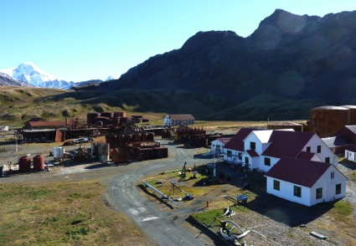
Develop a long-term management plan for Grytviken promoting management sympathetic to the original design and ethos, while incorporating modern health, safety and environmental requirements.
Develop maintenance and management plan for long term (15-20 yrs)
Integrate approved broader conservation projects and heritage management plans

Slide 45
Works 2015 - 2017
2015 – 2016
Slop Chest
Nybrakke
Potato Store
Stabilise bone loft
2016 – 2017
Engineers’ workshop
Nybrakke
Main stores
Internal church repairs

Slide 46
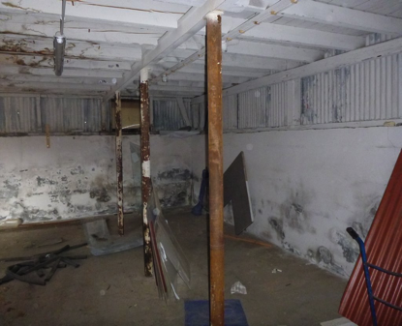
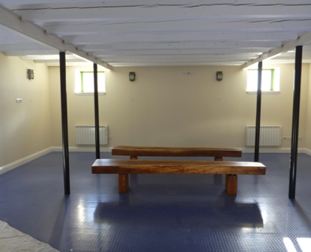
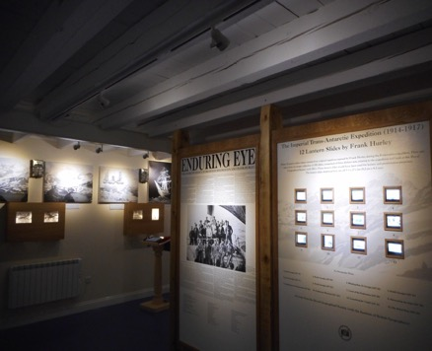
Slop Chest – Display Area

Slide 47
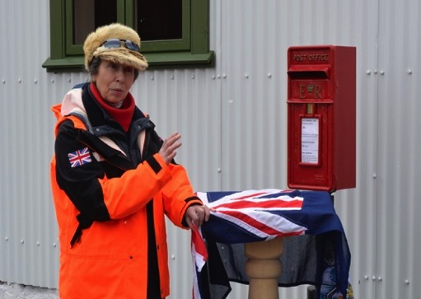
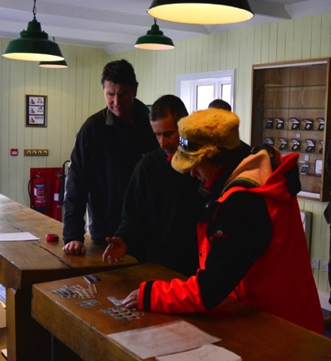
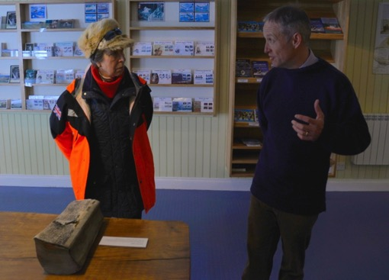

Slide 48
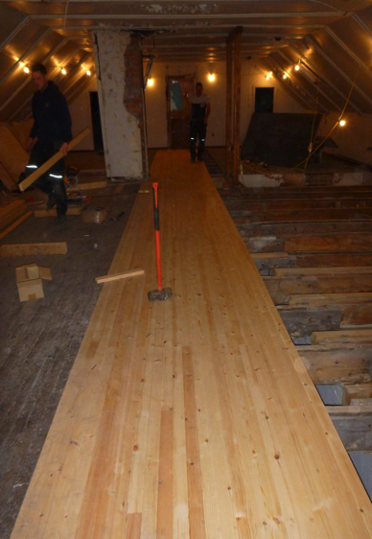
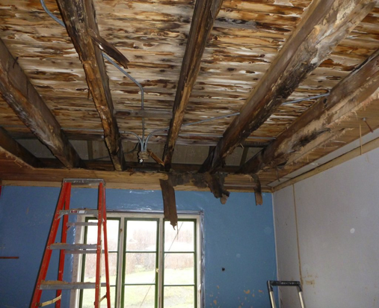
Nybrakke

Slide 49
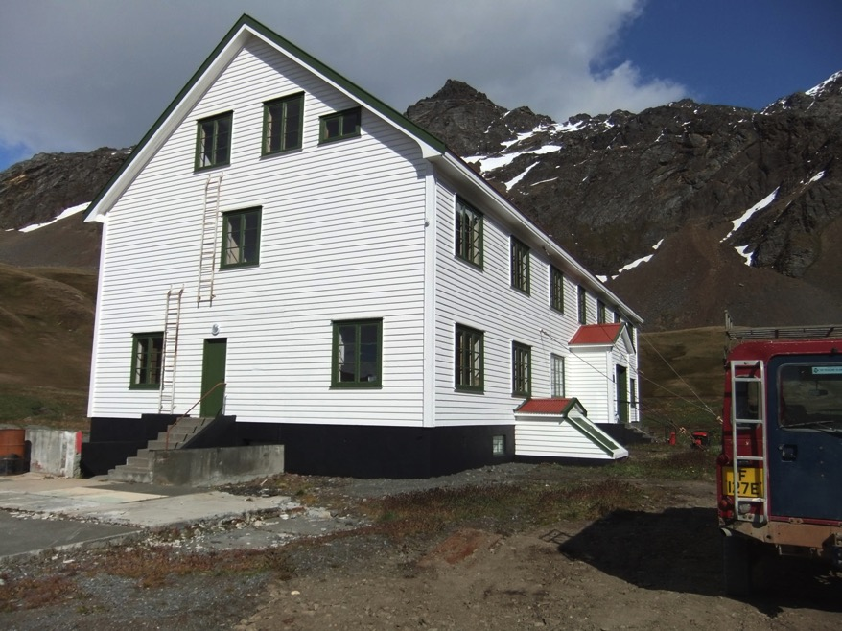

Slide 50


Potato Store

Slide 51

Cemeteries
Works undertaken 2016
Erection of new crosses at Ocean Harbour in early 2016, made from greenheart oak
By 2015 only 1 cross of 8 left standing; 6 replaced and 1 re-erected.

Slide 52


< - - Before (1990s)
After - - >
(2016)

Slide 53
Enhance communication and outreach of SGSSI’s heritage to a wider audience including through improved access to information at Grytviken and online access / return of artefacts
Geometria laser survey and Shadow Industries’ award-winning ‘kiosks’
Partnered Stanley Historic Dockyard Museum’s Shackleton Exhibition
Policy on the release and movement of artefacts (notwithstanding a presumption that artefacts should remain – and be returned!).

Slide 54

Viola / Dias

Slide 55
Evaluate the quantities and location of oil remaining in the whaling stations and sunken whale catchers and develop a plan to remove oil that is in line with both heritage and environmental aspirations.
Tender process underway for scoping project to provide options for removal of residual waste oil from former whaling stations
2013 survey included tank farms, day tanks, pump houses, pipelines, wastepits and sunken vessels.
Hazards include: asbestos, confined spaces, unsafe tanks

