Slide 1
GSGSSI Strategy Update - Fisheries
James Jansen
Government of South Georgia & the South Sandwich Islands

Slide 2
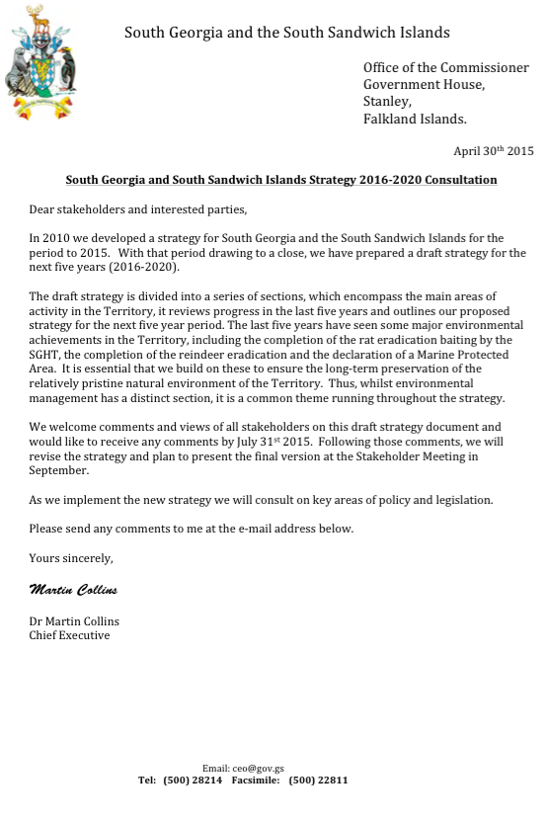
Consultation
3 months to end-July
43 responses
95% published online
diversity of views
review and finalise

Slide 3
Fisheries
recognition of a well-managed and sustainable fishery - how do we remain so?
scope to continue to raise standards (heavy fuel oil, bunkering, ice classification)
maximising the value of research and monitoring, and outreach and information-sharing
interest in, and support for, the review of the marine protected area in 2018 & monitoring plan
Key issue: charting a course between exploitation and conservation

Slide 4
Other key messages
best available data to inform management decisions, recognising uncertainties
role of monitoring in building knowledge and assessing impacts
need to think about how to manage marine invasive species
long-term environmental change needs capturing e.g. climate change
need for policy and legislation, including clarity of decision-making processes

Slide 5
Next Steps
review and finalise Strategy – launch November
reflect shared ambition. Will require shared ownership to implement
supported by annual business plan and good communications
monitoring, review and evaluation
Notes:
Develop an annual business plan to set out what we aim to achieve each year. Risk management part of good business planning. Need to communicate and outreach to ensure that the policies being taken forward are owned by stakeholders and that there is broader public awareness. In the 2016 business plan: updating fisheries legislation.
Annual assessment of progress in the annual report, plus a mid-term review of progress. Lessons learned.

Slide 6
Licensing Arrangements for 15/16
two-year licensing system for toothfish and icefish to continue;
continue to be precautionary – toothfish TAC seems likely to remain consistent with previous years;
vessels must be flagged to a CCAMLR Member State with an MoU with the UK to be eligible;
a Wreck Removal Certificate to be required as standard

