Slide 1
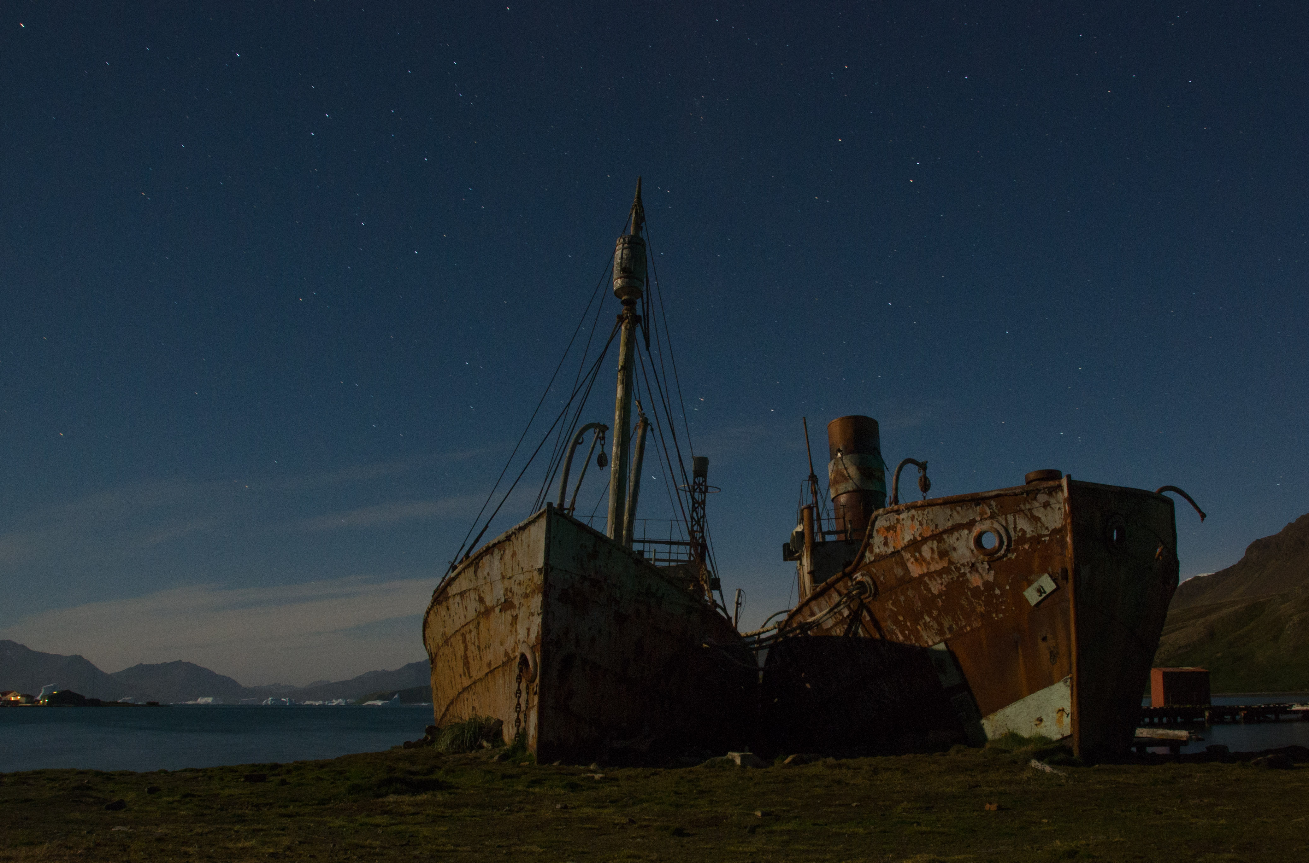
GSGSSI Annual Update 2015
James Jansen
September 2015

Slide 2
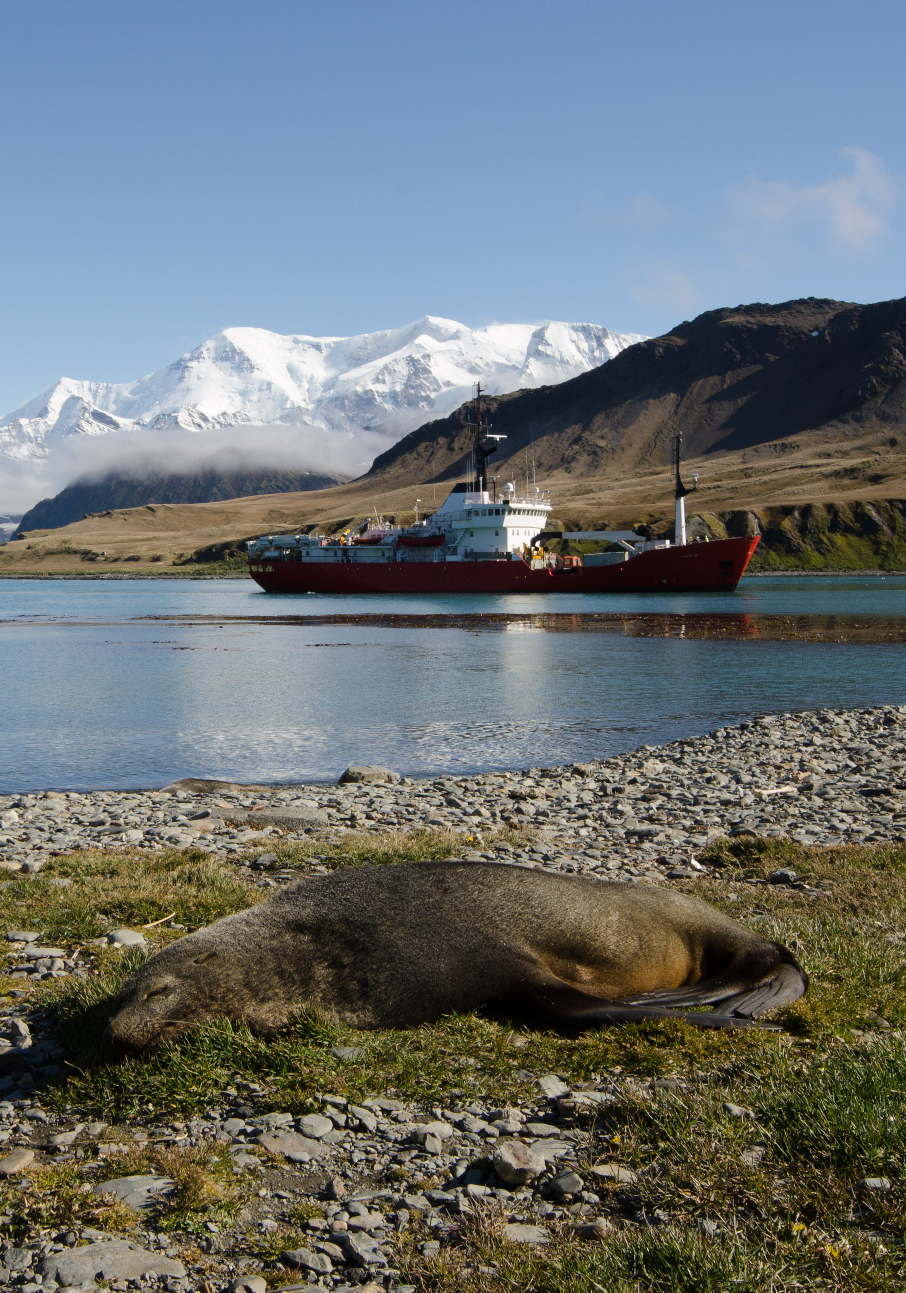
Government of South Georgia & the South Sandwich Islands
Annual Report 2015
Annual Report 2015

Slide 3
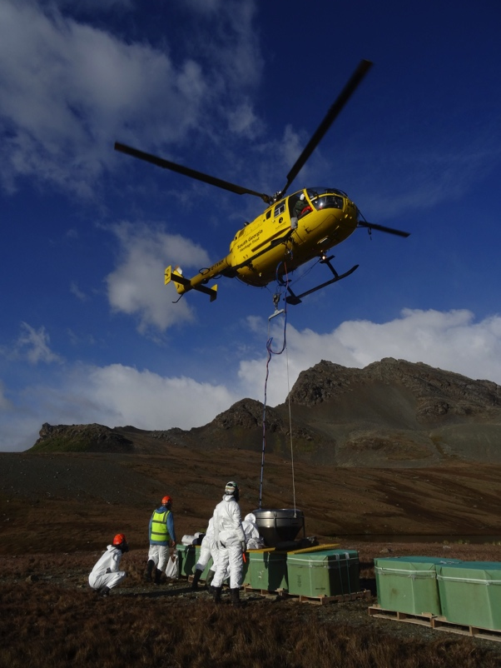
Environment
Final phase of rodent eradication
monitoring and biosecurity key
deployment of response plan
Reindeer project
dispatch of the “final 47”
Darwin weed management project
survey and control measures
Round island Albatross surveys
20% BBA / 40% GHA decline
Extension of Convention on Biological Diversity

Slide 4
Fisheries
Toothfish
limit 2200t; 2195t caught; 283g per hook; MSC re-cert
Icefish
trawl survey January 2015; 280t caught; fishing continues
Krill
c.55,000t (70,000t 2014)
Pharos
monitoring and boardings

Slide 5
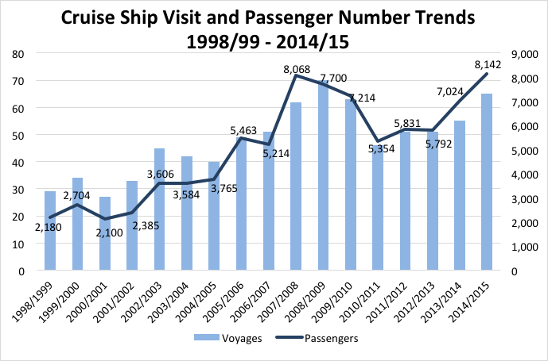
Tourism
2014/15 record year
65 cruise ship / 21 yacht visits
over 8000 passengers
6 expeditions
Review of cruise ship medical support – report pending
Respond to emerging issues such as the use of UAVs

Slide 6
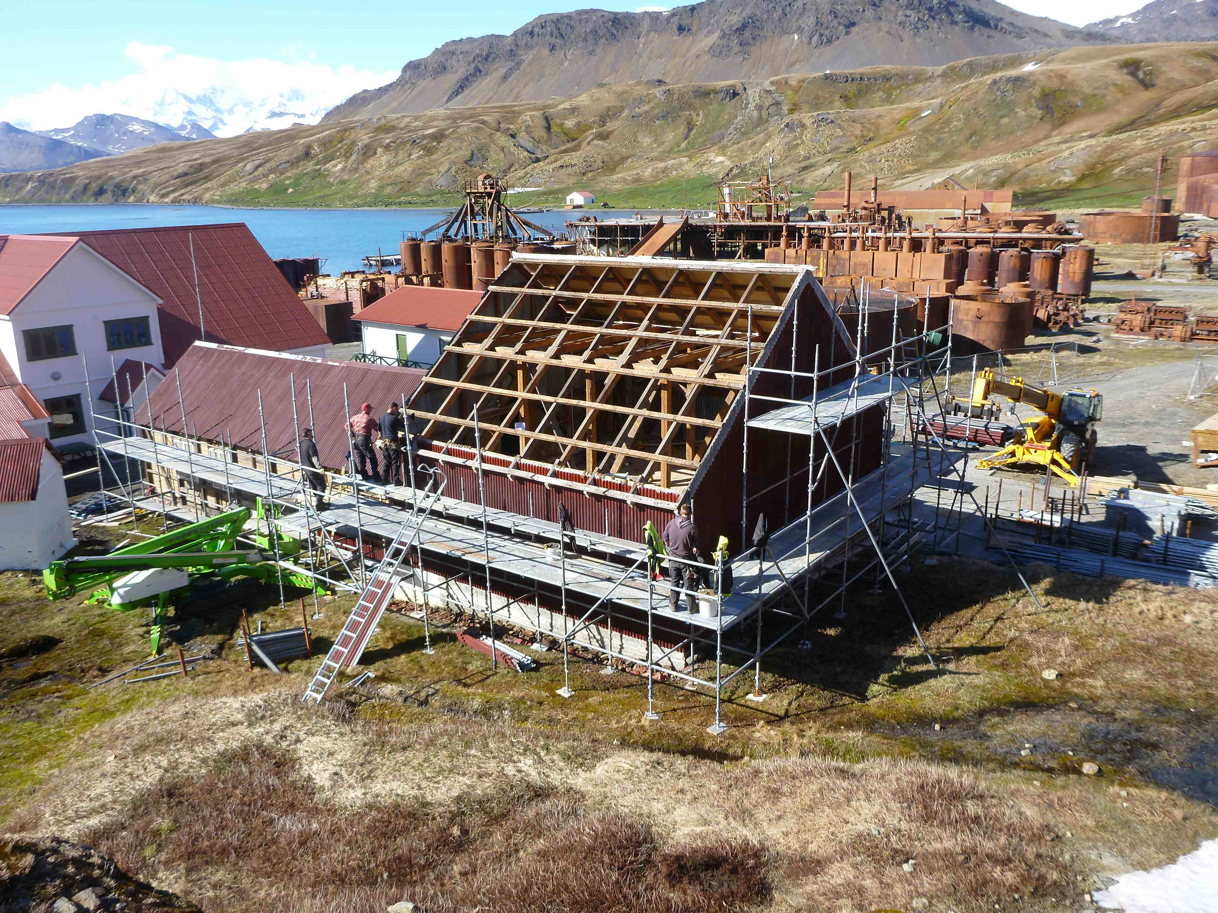
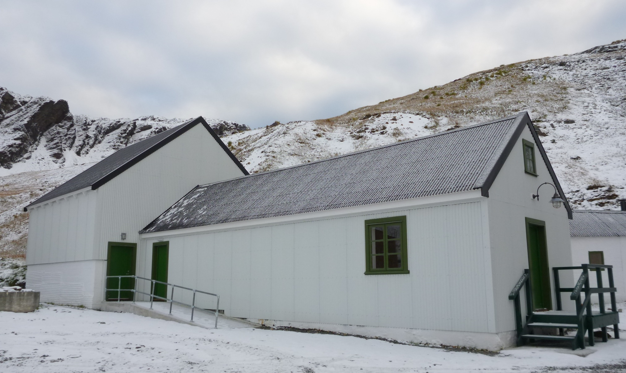
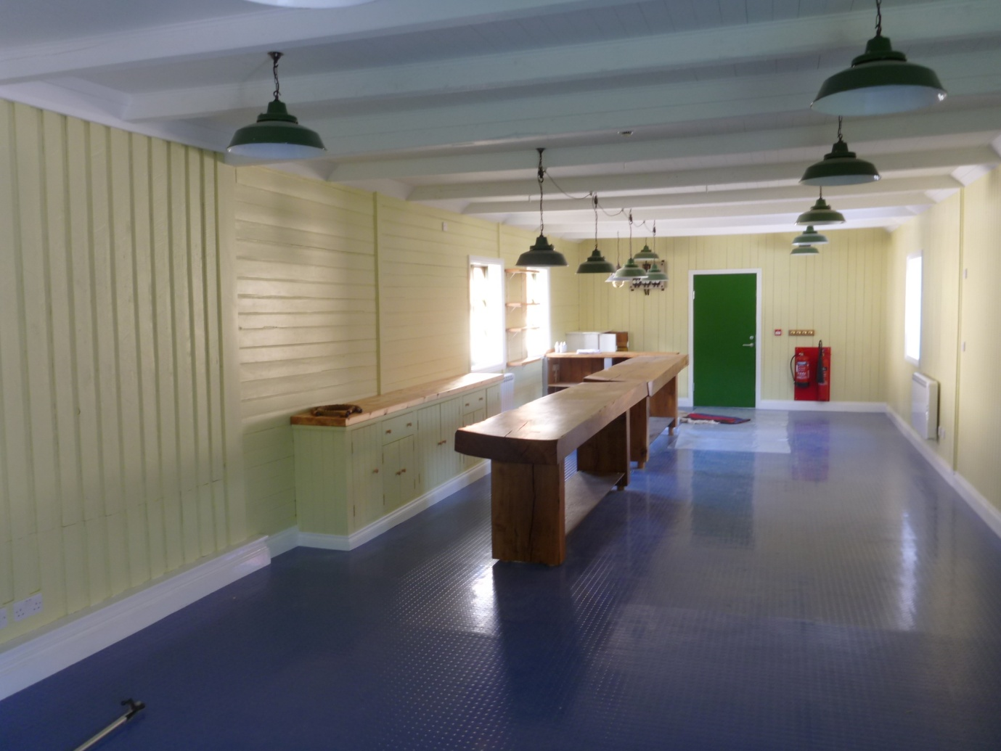
Heritage
Renovation of Slop Chest
new Grytviken Post Office
“Enduring Eye” & laser survey exhibition
Nybrakke works
interior renovation
Small building restoration
potato store
museum waste store
stabilise bone loft
GSGSSI/Norway collaboration
Grytviken maintenance plan

Slide 7
Governance
Consultation on GSGSSI Strategy 2016-2020
Legislative review
six priority areas including immigration, income tax, crime
publication online
Financial Accounts 2014
surplus of £1.37m – krill fishing and tourism helped boost income
expenditure £5.63m – MV Pharos and fishery management
Coins and stamps
definitive stamp issue: Scientists, Explorers and their Ships
new commemorative coins (SG coat of arms & humpback whale)
Risk management
review of contingency plan

