Slide 1
GSGSSI Strategy Update
James Jansen
Government of South Georgia & the South Sandwich Islands

Slide 2
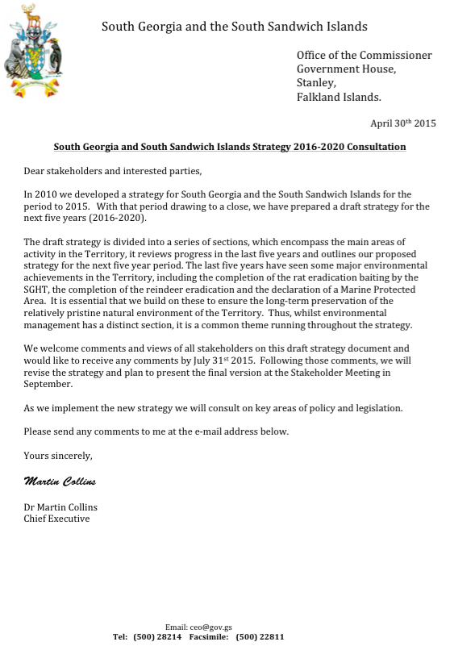
Consultation
3 months to end-July
43 responses
95% published online
diversity of views
review and finalise

Slide 3
Headlines…you said:
welcome opportunity and transparency
on the right track – agree headline objectives
bring out inter-relationships between issues
changes should be fair and evidence based
outreach important
diversity of interests, diversity of views

Slide 4
Environment
best available data to inform management decisions
role of monitoring in building knowledge and assessing impact of habitat restoration and MPA
deliver best practice biosecurity and manage invasive species
long-term environmental change needs capturing e.g. climate change
Key issue: balancing biosecurity
and conservation against operational requirements

Slide 5
Fisheries
recognition of a well-managed and sustainable fishery – continue to be precautionary
scope to continue to raise standards (e.g. heavy fuel oil, bunkering, ice classification)
maximising the value of research and monitoring, and outreach and information-sharing
interest in, and support for, the review of the marine protected area in 2018 & monitoring plan
Key issue: charting a course between exploitation and conservation

Slide 6
Visitor Management
apply rules consistently to all visitors while recognising tourist industry as a key player
ensure evidence-based management policy – onus on operator to act responsibly
potential to share education, outreach and communication of key messages
need for updated policy and legal framework i.e. a clear visitor management strategy
Key issue: balancing visitor/industry responsibility with Government oversight

Slide 7
Heritage
valuing, recording and protecting SGSSI’s cultural heritage
understanding and valuing heritage beyond whaling, including sealing and expeditions
reconciling access to heritage sites with health and safety
tackling the environmental impacts of decaying heritage sensitively
Key issue: balancing restoration with operational practicality

Slide 8
Governance
importance of consultation, transparency, and prudent financial management
need for policy and legislation, including clarity of decision-making processes
better using opportunities for collaboration, outreach and communications
demonstrating sovereignty through presence, public relations, stamps and coins
Key issue: developing a sound policy and legislative basis without unnecessary burdens

Slide 9
Enablers
Personnel
5.3 FTE Stanley; 3 rotating GOs KEP; building team; and YOU
Finances
annual expenditure of £5.5 – 6m plus outside support
Science
fundamental to our evidence base; need to be focused in support of delivering the Strategy
Infrastructure
Pharos; KEP; Grytviken; facilities in Stanley; BAS; RN; you

Slide 10
Next Steps
review and finalise Strategy – launch November
reflect shared ambition. Will require shared ownership to implement
supported by annual business plan and good communications
monitoring, review and evaluation

